Slide 1
ClimbCode
Notes:
Welcome to ClimbCode’s exposition. Here we’ll see how was our work this deliverable.

Slide 2

4
Notes:
We’re sure everyone remembers those days at high school in which they had a lot of homework to do, copying the questions and doing them to show them in class. A bit boring and tiring, wasn’t it? And also for the teacher, because he/she also needed to search in the books the exercises he/she wanted us to do.

Slide 3

5
Notes:
Then… What if there was back in those days a way to do both things easier and faster? A way to do those tasks in our computers?

Slide 4



Idea
+
=
ClimbCode
6
Notes:
The answer to this is ClimbCode, our web platform, which acts as a supporting tool for teaching subjects at schools with the help of software.

Slide 5


Idea
Interactive
7
Notes:
How do we grant this support? Simple, by interactive exercises, a better version of the original paper exercises made by independent programmers. Those exercises are bought by schools in order to increase their content catalog they have for supporting their subjects.

Slide 6
Our Path Today
Business
Workgroup & Weekly Progress
Pilot Plan’s Results
Marketing Plan
Lessons Learnt
2
Notes:
This is the path we’re going to follow during the presentation. First we’ll introduce the business behind ClimbCode, next we’ll introduce our working group and see our weekly progress, after that, we’ll talk about the results of our pilot plan and our marketing plan and finally about the lessons learnt during project.

Slide 7
Business
Notes:
We’ll start seeing which business involves ClimbCode.

Slide 8

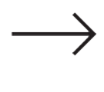
Business (I)
Schools buy licenses
8
Notes:
The first way to earn money with ClimbCode would be selling licenses to schools. These licenses would be active for a year and would allow the schools and academies to make use of the full platform for an entire academic year, renewing it each one to keep the services. Also with the license, schools and academies would have access to an amount of starting exercises that can be increased by buying more exercises.

Slide 9
Licenses
SIZE | USERS | FREE EXERCISES | PRICE
BASIC | 60 | 20 | 200€/y
MEDIUM | 200 | 50 | 550€/y
LARGE | 500 | 75 | 700€/y
9
Notes:
Then, we can order the different kinds of licenses we offer by the amount of users allowed to register and the number of starting exercises the client could access at first. That would lead us to these standard sizes of licenses, with their associated price. Also, in case of not finding a suitable size for them, the clients can always contact us in order to negotiate a suitable size and price of license for both of us.

Slide 10

Business (II)
Interactive
Schools buy exercises
10
Notes:
The second way we have for having a profit with these project is selling exercises. Interactive exercises have a buying price, which is payed for the schools and academies in order to increase the amount of exercises they have access to.

Slide 11


Business (III)
%
ClimbCode
%
Programmer gets money
11
Notes:
From this price, a percentage goes to the programmer, acting as a motivation for content creators for the platform, and another percentage is kept for us.

Slide 12
Workgroup & Weekly Progress
Notes:
Now we’ll introduce our group members and see the things we’ve already done in our project.

Slide 13
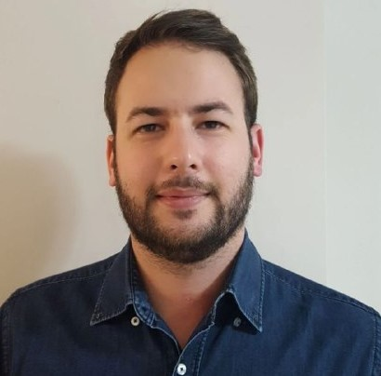

The Workgroup
Alejandro Román Rodríguez
Project Manager
Álvaro Domínguez Núñez Business Manager
13
Notes:
Our members are Alejandro Román, the project manager, Álvaro Domínguez, the business manager…

Slide 14
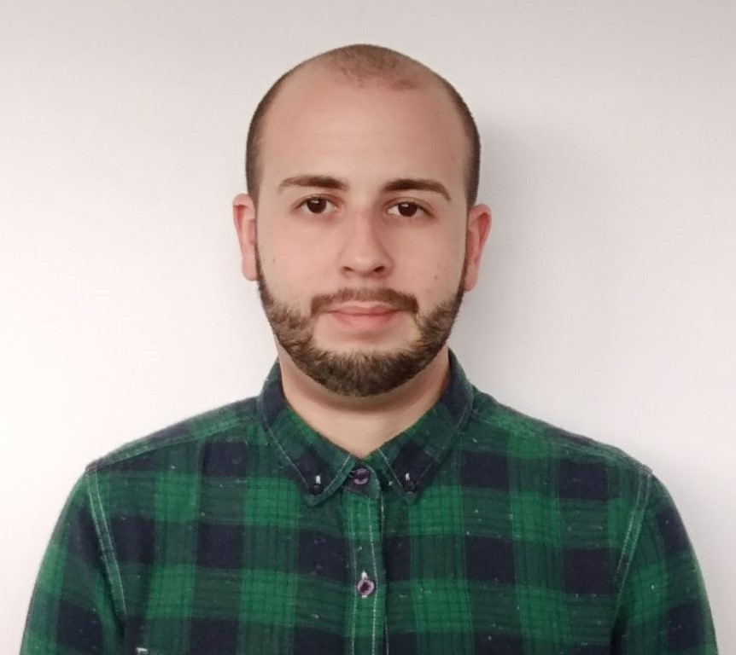
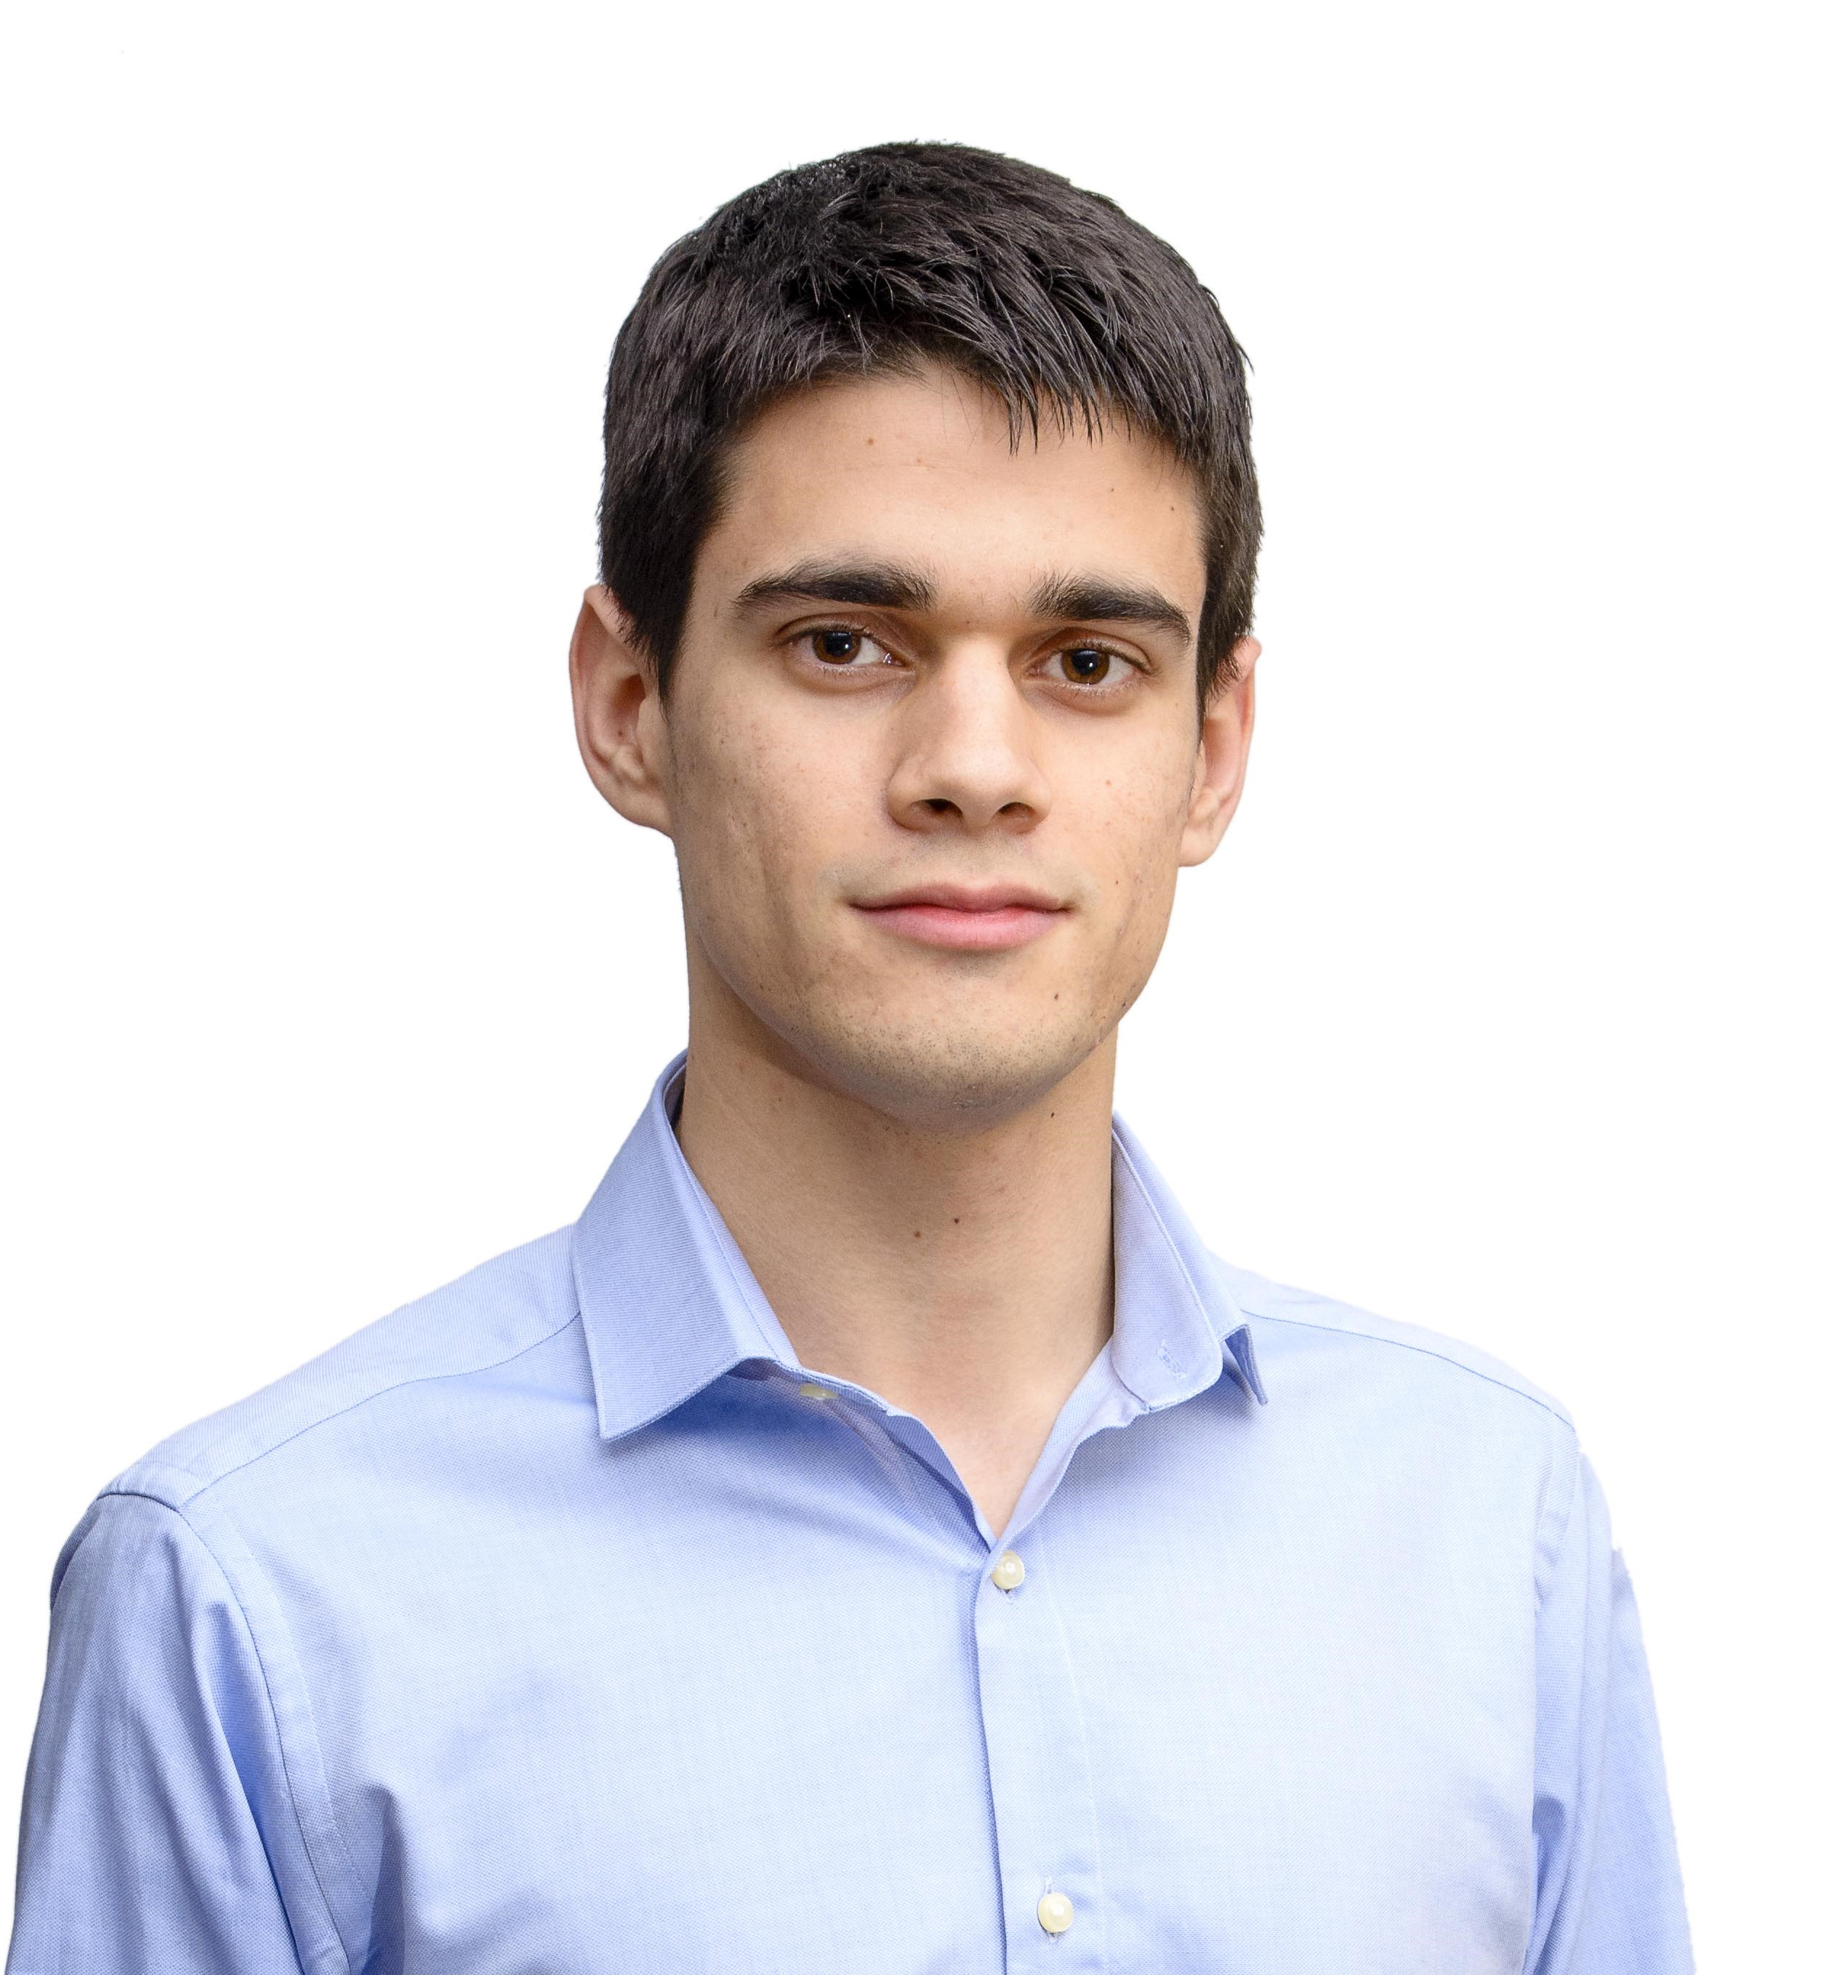
Front-End Developers
Miguel Ángel Baños Carretón Front-End Developer
Alejandro Garrido Resina
Front-End Developer
14
Notes:
Our front-end developers: Miguel Ángel Baños and Alejandro Garrido…

Slide 15
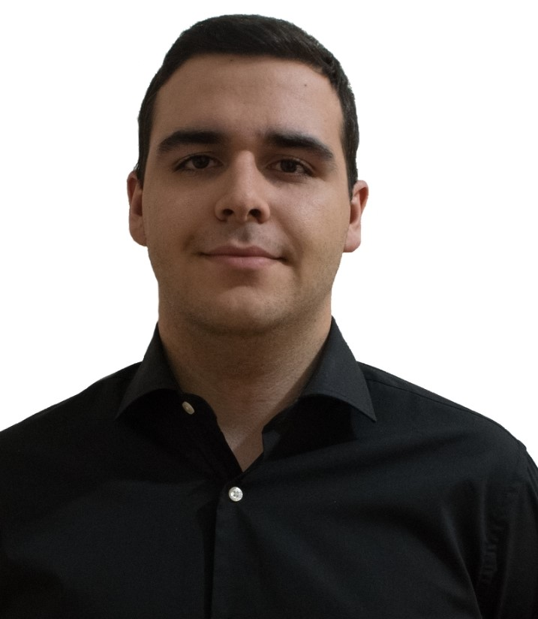
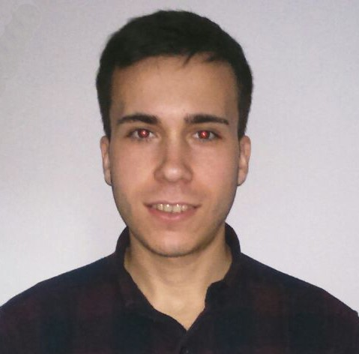
Back-End Developers
Andrés Fernández Alés
Back-End Developer
Álvaro Sánchez López
Back-End Developer
15
Notes:
And our back-end developers: Andrés Fernández, Álvaro Sánchez…

Slide 16
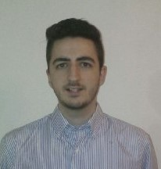
Back-End Developers
Jesús Sosa Sánchez Back-End Developer
16
Notes:
And Jesús Sosa. These are the seven members of the workgroup.

Slide 17


Completed: MVP
Transactions
Interactive
Ordinary Use Cases
17
Notes:
In terms of features that our platform offers, we’ve finished all the ones we had as our MVP: Our interactive exercises’ system, allowing it to create and save them on our platform, our transactions’ system, allowing to buy and sell interactive exercises and letting programmers get their money from the purchases of the exercises, and many other minor use cases of our Django model.

Slide 18



Completed: Others
Security
Style
Feedback
18
Notes:
Those features also include solving security problems, the preparation and correction of the style of our platform, and the implementation of all the feedback we’ve got during our pilot plan and that we could include in our project.

Slide 19



Week’s Focus
Maintenance
Marketing Plan
Pilot Plan Analysis
19
Notes:
These weeks, though, we’ve been focused in creating our marketing plan, analysing the results of our pilot plan in order to get as many users as possible and keeping the maintenance of our platform.

Slide 20
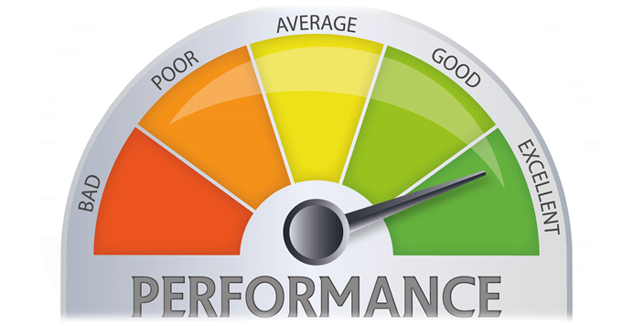
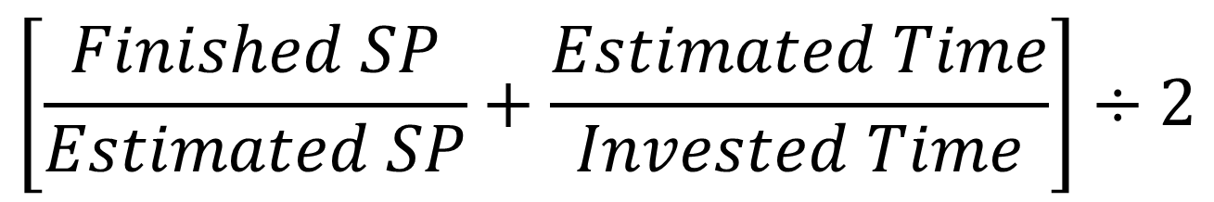
Performance’s Metric
$$\left[\frac{Finished SP}{Estimated SP}+\frac{Estimated Time}{Invested Time}\right]÷2$$
BAD: <85% ACCEPTABLE: 85-100% GOOD: >100%
20
Notes:
We’ve also updated our metric to measure the performance of our team members in matters of tasks. The new version of the metric uses both our story points’ estimation and the amount of time estimated and worked.
This performance shows a good work for a member if it is above 100%, the accepted work for a member if it is between 85 and 100%, and a bad one if it is below 85%.

Slide 21
Weekly Performance
21
Notes:
To see how our work went this week, we’ve included this graphic in which we can show the performance of each member in the progress of this sprint, as we see, the best members in terms of performance were Álvaro Dominguez, Álvaro Sánchez and Andrés Fernández.

Slide 22
Current Costs & Time
50%
971 h
0%
100%
€19K
€29K
1120 h
Current: €64%, 86% h
Budgeted: €62%, 62% h
22
Notes:
To achieve all this progress, we’ve spent a total amount of 936 hours and 18k euros currently, which is a 86 and a 64 percent from the total, and different from the 62 expected this week.

Slide 23



Costs’ Explanation
Direct Costs: €14k
Indirect Costs: €4,6k
23
Notes:
That money investment is divided in direct and indirect costs, having the amount shown in the slide for each one.

Slide 24

Deployment & Demo
Deployment URL: www.climbcode.tk
Demo
24
Notes:
To show how the system works today, we’ve put a link in which everyone can see our project, and also we’ve created a demo, showing our star use case: The creation and buying of an interactive exercise.
Demo: https://www.youtube.com/watch?v=_pAyQNXK4IY
Paypal’s credentials for a school: schoolCC@hotmail.com / climbcodeISPP2018
Admin Account: administrador / climbcode

Slide 25
Pilot Plan’s Results
Notes:
Now we’ll see the results of applying our pilot plan.

Slide 26


Pilot Plan
Meetings with Programmers
26
Meetings with Schools
Notes:
We designed a pilot plan based in meetings with programmers and teachers, showing them our platform, how an interactive exercise is and works, and asking them what did they think about our star use case (creation and purchase of interactive exercises), what suggestions did they have for our project, what did they think we could change, and how much would they pay for each thing of our platform (licenses and exercises).

Slide 27



Results: Feedback
Automatic Registration
Student’s
Security
No Programming
27
Notes:
From the feedback we received, we decided to include the automatic registration of teachers and students with a .csv file to save time to schools and to keep safe the student’s personal information.
Also, our school users didn’t seem interested in programming in our platform or learning to do it, so we decided to focus in our interactive exercises.

Slide 28
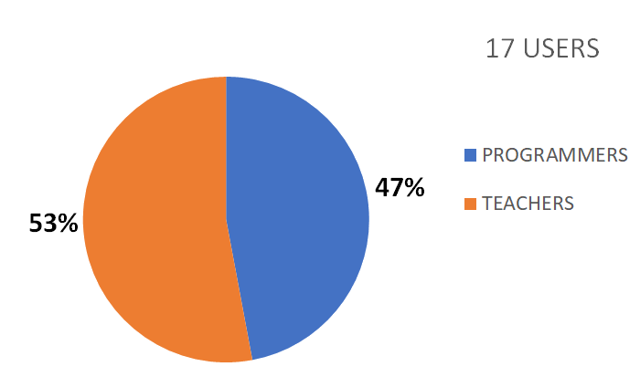
Results: Figures (I)
28
Notes:
As a result of our pilot plan, we’ve got an amount of 17 users for our platform, from the 26 inverviewed, divided bewteen teachers and programmers as we see in the graphic.

Slide 29
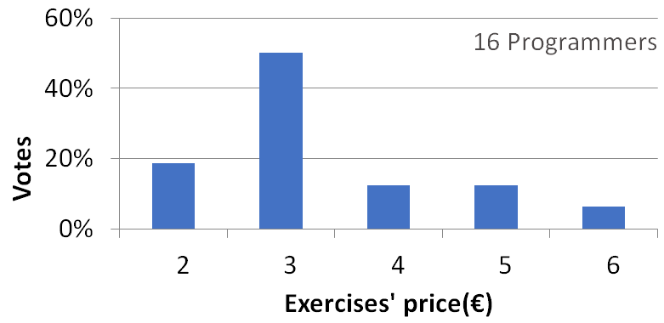
Results: Figures (II)
Exercises’ price (Programmers)
29
Notes:
From all the programmers we’ve interviewed, the highest amount of them thought that 3 euros for each purchase of an exercise was a fair price.

Slide 30
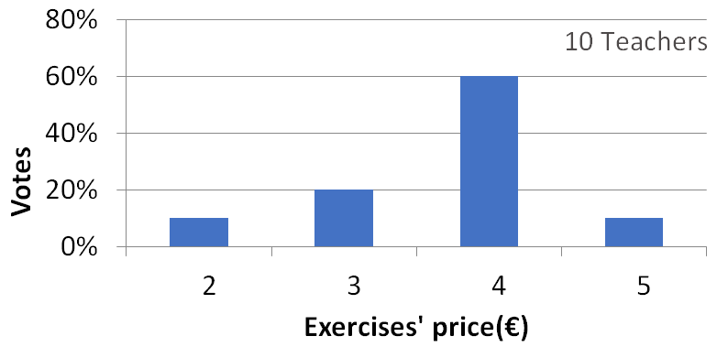
Results: Figures (III)
Exercises’ price (Teachers)
30
Notes:
Also, we’ve asked the schools for those prices, showing that they mostly think that a price of 4 euros would suit the purchase of an interactive exercise.

Slide 31
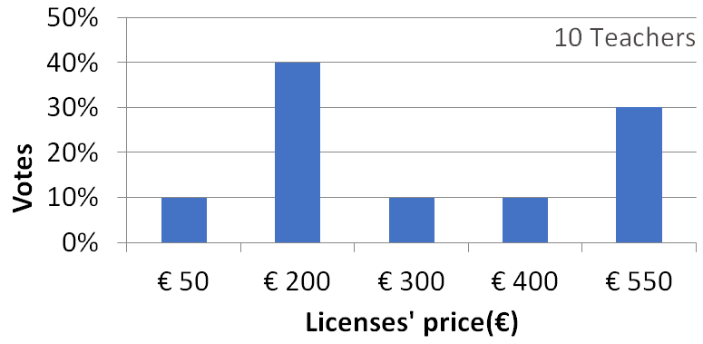
Results: Figures (IV)
Licenses’ price (Teachers)
31
Notes:
Finally, we asked the schools about the prices suitable for the annual licenses, and most of them would pay 200 or 550 euros, depending on their available funds.

Slide 32
Marketing Plan
Notes:
Now we’ll talk about our marketing plan.

Slide 33
Marketing Plan: Situation
SCHOOLS
PROGRAMMERS
33
Notes:
Nuestra plataforma posee usuarios tanto programadores como de escuelas, así que nuestro plan de marketing va enfocado a estos dos colectivos.

Slide 34





Marketing Plan: Actions
Social Networks
Promo
Marketing Meetings
Banners
34
Notes:
Así pues, tenemos planeado hacer campañas publicitarias por redes sociales, cuyo proceso ya hemos comenzado en twitter. También tenemos planeado hacer un vídeo promocional que añadiremos a nuestra página principal y del que ya tenemos algunas tomas, además de realizar reuniones con el objetivo de atraer nuevos usuarios enseñándoles nuestro proyecto y mediante el uso de banners publicitarios.

Slide 35
Lessons Learnt
Notes:
Finally, we’ll see the lessons learnt during the project.

Slide 36



Lessons (I)
PROBLEM | LESSON
 | ESTIMATION TECHNIQUES
36
Notes:
During the project’s development we found an amount of important problems related to managment. The first of them was that we found hard to document all the problems we were discovering. From this problem we’ve learnt an efficient way to document those problems, which we can use in the future if any other appears.
Another problem we found was that it was hard to estimate our tasks, so we had to find a way to do it properly. From this situation we’ve learnt a lot of strategies to measure and estimate tasks, such as the usage of priorities and story points, which we will continue using in the future.

Slide 37



Lessons (I)
PROBLEM | LESSON
 | RELATION ISSUE-COMMIT
37
Notes:
Otra lección aprendida surge de nuestro problema con las tareas grandes. Esta lección consiste en que ahora conocemos bastantes estrategias para dividir tareas, lo cual seguiremos aplicando en el futuro para maximizar nuestra eficiencia en las estimaciones.
La última de las lecciones surge de un problema con respecto a la gestión, en el cual no se completaba adecuadamente la trazabilidad entre tareas y requisitos. A partir de esta situación hemos establecido un sistema de relaciones entre las tareas y los commits que hacemos en el equipo de trabajo.

Slide 38

Conclusions
KEEPING ON THE WAY
38
Notes:
So, as a conclussion, at first we found hard to adapt to the new working focus, but as we went on, we found out that which a constant growing in our users and the completion of our marketing plan, we can achieve all the goals purposed for this deliverable. That is the reason of why do we keep positive during the progression of our project these days.

Slide 39

THANKS!
You can find me at
alvdomnun@alum.us.es
39
Notes:
And that’s the end of our presentation! Thank you for watching, and if you have any doubt you can contact me at alvdomnun@alum.us.es.

